Slide 1

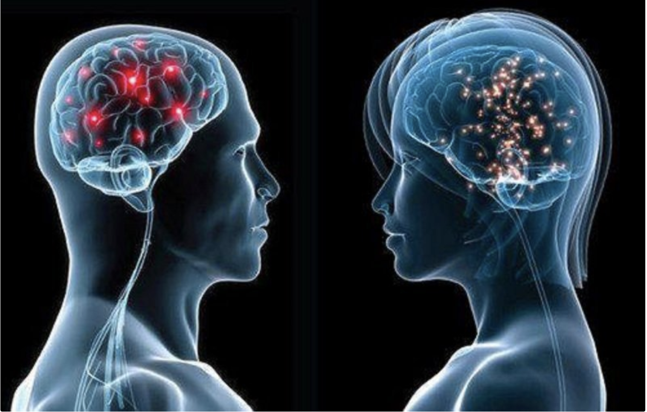
We Care:
Team ID: 127
Brain Tumor classification using Deep Learning
To generate visualizations from the data we gathered using survey from our healthcare website.
Also make sure to address here:
Dave, IT Professional.
It is based on Patient Experience using AI and Machine Learning addressing the health disparities keeping privacy and security as a prominent priority.
The survey data of general public along with their MRI scans is used. The model uses MRI Scans from sites(approx. 7000 images) for training purpose.

Slide 2
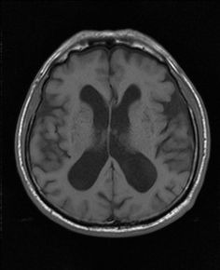
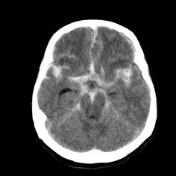
Team ID: 127
Provide additional details about your idea/current development here, including:
This can include visuals or a short video (no more than 1 minute), etc. here
Brain tumor is considered as a life threatening disease among children and adults. To enhance the life expectancy of the patients it’s very important to implement proper treatment planning and get accurate diagnostics.
In future we can collaborate and analyze various other cancer types. This can help people to self analyze and get their analysis by just filling out a survey.
Helps in booking appointment and find nearest hospitals and also can get online consultation with a few clicks. [ exclusively cancer patients]

